Slide 1




ACT: Architectural Carbon Modeling Tools
@ MICRO 2022
Tutorial
Udit Gupta

Slide 2

ACT Tutorial: Today
Time | Topic
1:00 – 1:15pm | Introductory remarks
1:15 – 1:30pm | Motivation: Understanding the source of computing’s emissions
1:30 – 2:15pm | Overview of ACT: An Architectural Carbon Modeling Tool
2:15 –2:30pm | Coffee Break
2:30 – 3:00pm | Hands-on ACT demo’s
3:00 – 3:15pm | Extending ACT
3:15 – 3:45pm | Office Hours
3:45 – 4:00pm | Closing remarks
Notes:
Finally, given our understanding of carbon emissions, we will conclude by charting paths for how to design future sustainable computing systems.

Slide 3

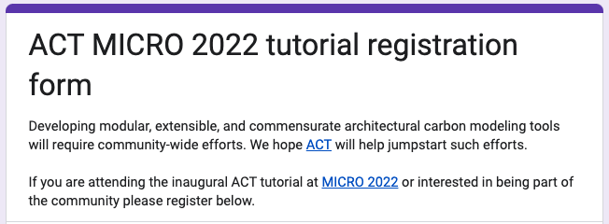
Sing up on our Google form!
https://forms.gle/hEAju2suaeEnisRQA

Slide 4

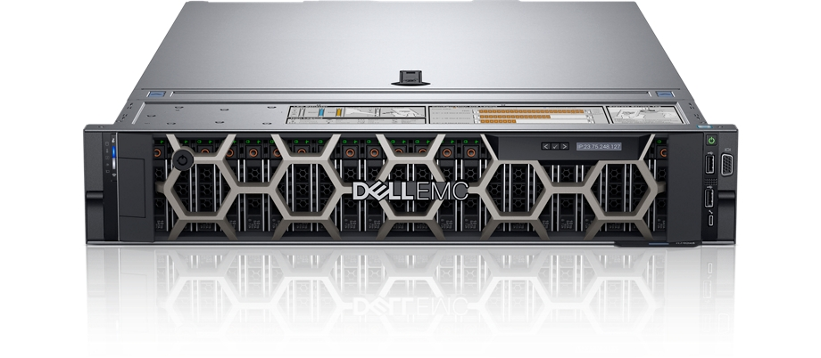
Estimating the embodied footprint of 2 devices using ACT
IC component | ACT vs. Dell R740 server LCA | ACT vs. Fairphone 3 mobile device LCA
Compute (processors, SoC’s) | Within 2.2x | Within 1.18x
Memory | Within 1.62x | Within 2.1x
Storage | Within 1.05-2.2x
Takeaways
ACT provides first-order approximate of LCA’s that use old technology nodes (45nm NAND, 32nm CPU)
ACT enables architects to study new technology nodes

Slide 5

How to set up ACT
>$ git clone https://github.com/alugupta/ACT.git
>$ cd ACT/
>$ source setup.sh
>$ python model.py
https://github.com/alugupta/ACT
[Fab logic] Carbon/area from energy consumed 1209.5
[Fab logic] Carbon/area from gasses 240
[Fab logic] Carbon/area from materials 500
[Fab logic] Carbon/area aggregate 2228.0

Slide 6
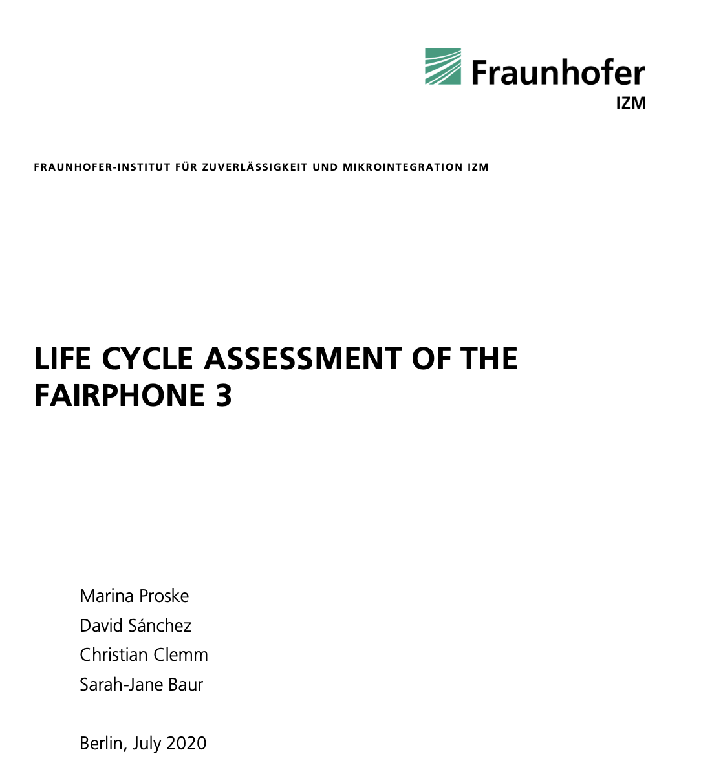
Estimating embodied footprint of Fairphone 3
https://www.fairphone.com/wp-content/uploads/2020/07/Fairphone_3_LCA.pdf
# Make sure you are in root directory
>$ cd ACT
>$ python tutorial/fairphone3_tutorial.py
--------------------------------
ACT RAM + Flash 0.0 kg CO2 vs. LCA 11 kg CO2
ACT CPU 0.0 kg CO2 vs. LCA 1.07 kg CO2
ACT ICs 0.0 kg CO2 vs. LCA 5.3 kg CO2
Full end to end example can be found here: https://github.com/alugupta/ACT/blob/main/exps/fairphone3/fairphone3.py

Slide 7
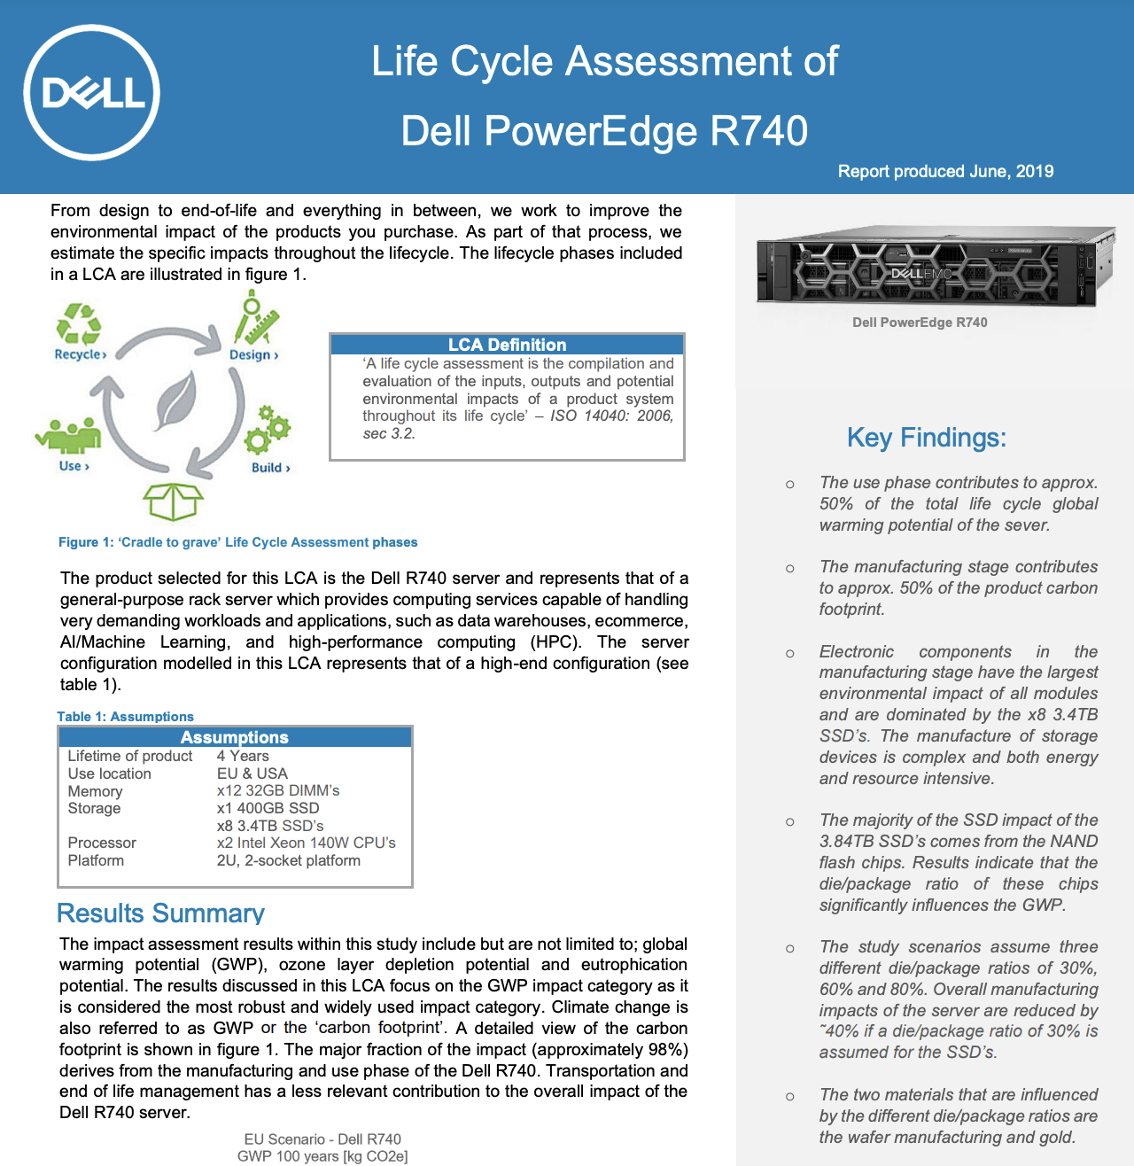
Estimating embodied footprint of Dell R740
https://corporate.delltechnologies.com/content/dam/digitalassets/active/en/unauth/data-sheets/products/servers/lca_poweredge_r740.pdf
# Make sure you are in root directory
>$ cd ACT
>$ python tutorial/dellr740_tutorial.py
--------------------------------
ACT SSD main 0 kg CO2 vs. LCA 3373 kg CO2
ACT SSD secondary 0 kg CO2 vs. LCA 64.1 kg CO2
ACT DRAM 0 kg CO2 vs. LCA 533 kg CO2
ACT CPU 0 kg CO2 vs. LCA 47 kg CO2
Full end to end example can be found here: https://github.com/alugupta/ACT/blob/main/exps/dellr740/dellr740.py

Slide 8
ACT Tutorial: Today
Time | Topic
1:00 – 1:15pm | Introductory remarks
1:15 – 1:30pm | Motivation: Understanding the source of computing’s emissions
1:30 – 2:15pm | Overview of ACT: An Architectural Carbon Modeling Tool
2:15 –2:30pm | Coffee Break
2:30 – 3:00pm | Hands-on ACT demo’s
3:00 – 3:15pm | Extending ACT
3:15 – 3:45pm | Office Hours
3:45 – 4:00pm | Closing remarks
Notes:
Finally, given our understanding of carbon emissions, we will conclude by charting paths for how to design future sustainable computing systems.

Slide 9
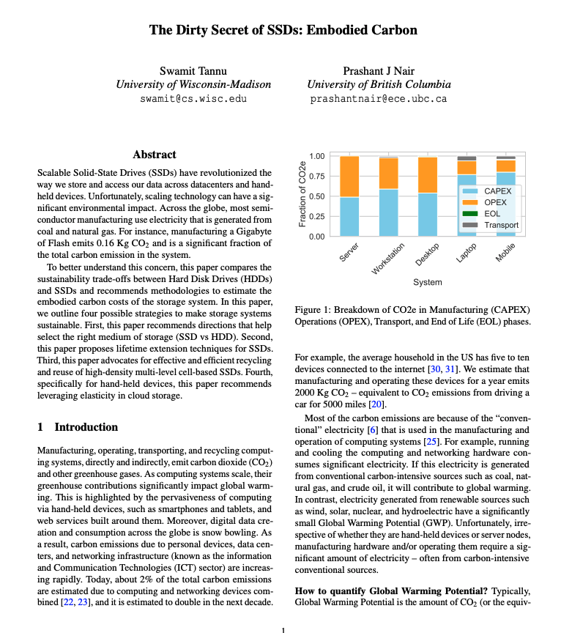
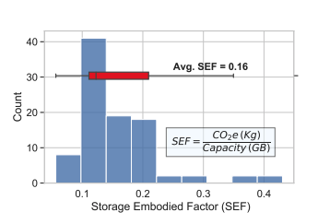
Extending ACT with new SSD model
https://hotcarbon.org/pdf/hotcarbon22-tannu.pdf (HotCarbon workshop 2022)

